Slide 1


Turning Your
Data into Dollars:
The RevEfficiency Model
Shawn Peterson | CEO Quantum Business

Slide 2
TOC: Day 2
Introduction
Step 3: Multiply
Q&A
Quantum’s Rev Efficiency Model
Step 4: Convert
Next Steps
Step 1: Keep
Step 5: Expand
Step 2: Grow
Today’s Offers

Slide 3

Shawn Peterson
MEET OUR CEO & FOUNDER
Shawn Peterson is the CEO of Quantum Business Solutions, where he brings over a decade of executive-level experience in the technology services industry. A forward-thinking visionary, Shawn excels in driving high growth and superior performance through innovative strategies in sales, marketing, and client experience. His expertise extends to leveraging cutting-edge technologies, including automation, AI, and comprehensive tech stack integration, to enhance operational efficiency and financial performance.

Slide 4

About Quantum
Quantum Business Solutions specializes in optimizing your sales and marketing strategies for success through:
Go-To-Market Strategy, Specifically Tailored for the Office Technology Industry
Sales Tech Integrations
Lead Generation Services

Slide 5

Katie Landaal
SVP for Global Alliances and Ecosystem at ZoomInfo
Katie is a strategic partnership leader with over 18 years of experience in the SaaS industry. She has facilitated strategic partnerships with Google, Microsoft, AWS, Salesforce, and many more household names.

Slide 6

About ZoomInfo
ZoomInfo is a leading intelligence platform that provides accurate and up-to-date business information to enhance sales and marketing efforts. By offering comprehensive data on contacts and companies, ZoomInfo helps organizations streamline lead generation, improve prospecting, and drive more effective outreach campaigns. Its powerful analytics and insights enable businesses to make informed decisions, optimize their sales processes, and achieve higher conversion rates. With seamless integration capabilities, ZoomInfo can be easily incorporated into existing CRM systems, providing a unified platform for data management and strategic growth.

Slide 7
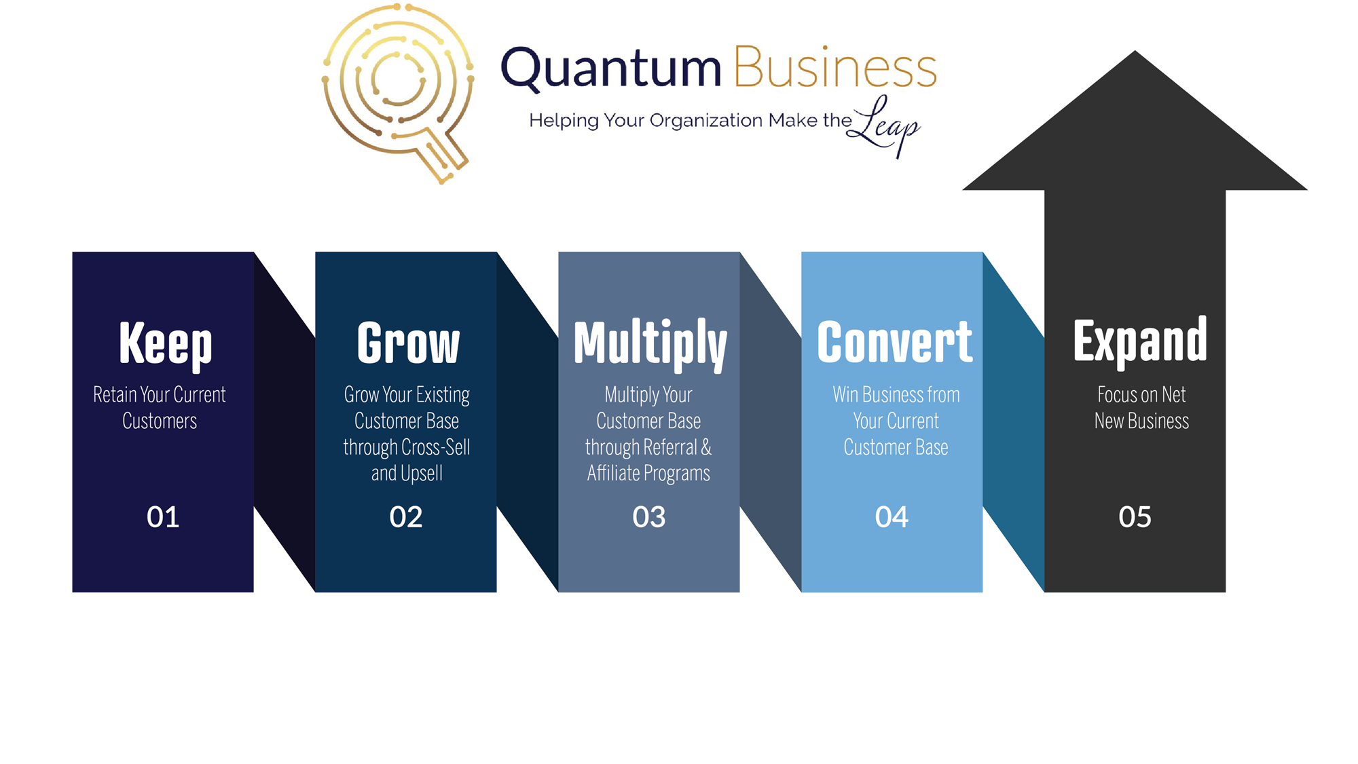
Leverage
Data Into
Sales
Quantum’s RevEfficiency Model

Slide 8
Step 1: Keep
Retention
Know Your Current Customers

Slide 9
Customer Contacts
Do you have the right customer contacts in your database?
For existing customers, how many CEOs/heads of companies are currently in your CRM?
How many head of IT and head of Finance customer contacts are in your CRM?
Relationships that Matter

Slide 10
Database Enrichment
Mobile Phone Numbers
Direct Dial Phone Numbers
Email Addresses
Data You Need for Key Contacts for Each Customer Account

Slide 11
Data Enrichment
Less than 6 months ago
6 months to 1 year ago
1+ years
3+ years
Longer?
When was your last data enrichment? Is your data current?

Slide 12
Data Decay
Contact Data Degradation Rate:
Annually: On average, B2B data decays at a rate of approximately 30% per year.
Monthly: This translates to about 2.5% per month.
Job Changes:
Annually: About 20-25% of employees change jobs each year, which can significantly impact contact data accuracy.
Monthly: Approximately 1.75-2% of employees change jobs each month.
Statistics

Slide 13
Segment Data
Basic Segmentation
  Leads
  Customers
  Former Customers
Intermediate Segmentation
  Ideal Client Personas
  Buyer Personas
  Industry
Advanced Segmentation
  Lead Score
  Behavioral
  Demographic & Firmographic
  Technographic
  Event Based
  Lifecycle Stages
  Custom Insights
  Campaign Engagement
  Etc.
How in-depth is your segmentation?

Slide 14
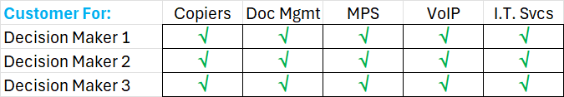
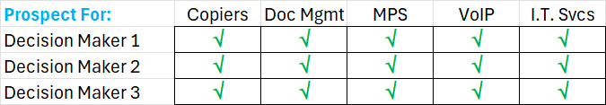
Current Customer Segmentation
What products and services does each customer have?
What products and services is each customer a good fit for?
Who are the decision makers for each option?
Where is this information housed and how is it leveraged?
Have you identified the right decision-makers for your products and services?

Slide 15
Protect the Revenue Closest to You
Product/Service
Prospect for Product/Service
Engagement Level
Purchase History
Feedback/Survey Responses
Identification and Tracking of Champions Within the Organization
Technologies Used
Loyalty Program Membership
Account Size
Contract Renewal Rate
Communication Preferences
Existing Customer Segmentation

Slide 16
Current Customer Insights and Triggers
Key Contact Moves
Champion Moves
Customer is Growing
Customer Intent
Customer Purchases New Technology
Customer Job Postings
Marketplace Changes
Mergers & Acquisitions
Consolidation
Key moments and behaviors that signal the need for engagement.

Slide 17
Systemized Retention Strategies
Automated, but Personalized Communication
Loyalty Programs
Educational Content and Resources
Renewal Reminders and Incentives
Automated Nurture Campaigns
Regular QBRs and Ability to Leverage Findings
By leveraging targeted segmentations, you can implement effective, personalized retention efforts that drive meaningful results.

Slide 18

Step 2: Grow
Cross-Sell
Upsell

Slide 19
Untapped Opportunities
Are you satisfied with your current cross-sell rate?
Do you believe there is a lot of money being left on the table within your current customer base?
“It is 5-25 times more expensive to acquire a new customer than it is to retain an existing one."
(Source: Harvard Business Review)

Slide 20
What We Know
Our customers tell us 25% of their customer base should be prime candidates for cross-sell opportunities.
These customers typically have 25-100 employees.
When we initially analyze data in their CRMs, we find the following:
Less than 5% of their contacts match their key buyer personas.
Of the contacts that do match their key buyer personas, less than 40% have mobile numbers, less than 50% have direct dial numbers, and less than 85% have email addresses
Data Needed to Cross-Sell and Upsell Your Current Customers

Slide 21
Pinpoint and Complete Data Gaps
Decision Makers
Champions
Contact Information
Company Size
SIC Codes
Industry
Revenue
Employee Count
Job Titles
Technographic Data
Geographic Location
Company Headquarters
Subsidiaries
Recent Company News
Funding Information
Social Media Profiles
Purchase Intent Data
Ensuring Comprehensive Data: Decision Makers, Contact Info, Company Size, SIC Codes, and More

Slide 22
Leverage Champions
Build Strong Relationships
Engage Them in Product Feedback
Highlight Their Success Stories
Invite Them to Speak at Events
Involve Them in Beta Testing
Provide Exclusive Access to New Features
Create Case Studies Featuring Their Success
Encourage Internal Advocacy
Facilitate Networking Opportunities
Share Their Insights and Best Practices
Feature Them in Customer Testimonials
Collaborate on Co-Branded Content
Invite Them to Advisory Boards
Involve Them in Referral Programs
Seek Their Help in Expanding Reach
Recognize Their Achievements Publicly
Encourage Social Media Advocacy
Leverage Their Influence for Cross-Selling
Have you identified champions within your customer organizations?

Slide 23
Highlighting Your Products and Services
Do your customers know the full spectrum of your products and services?
How is this information disseminated to them?
Have you ever had a customer tell you they just signed with another vendor for a service you offer?
Communicating Your Complete Product and Service Range

Slide 24
Leveraging QBRs, Installs, and Service Calls
Do you have an automated and systemized approach for scheduling QBRs?
How is the data collected during QBRs, Installs, and Service Calls?
Where is the data stored?
How is the data leveraged?
Actionable Insights Resulting from QBRs

Slide 25

Step 3: Multiply
More Meetings

Slide 26
Referrals
Define Goals and Objectives
Identify Referral Incentives
Set Clear Rules and Guidelines
Create a Referral Request Process
Design Promotional Materials
Leverage Technology
Communicate the Program
Train Your Team
Monitor and Measure Performance
Follow Up with Participants
Adjust and Optimize
Celebrate and Highlight Successes
Steps to Implement a Customer Referral Program

Slide 27
Leverage Champion Moves
Systemized tracking of champion moves
Importance of multiple contact points
Leverage champions transitioning to new organizations.

Slide 28
Fostering Relationships with Champions Who Transition
Maintain Regular Communication
Celebrate Their Successes
Offer Support During Transition
Provide Updated Information on Your Offerings
Encourage Referrals and Introductions
Create Personalized Welcome Packages for New Roles
Track Their Influence and Impact in New Roles
Leverage Their Feedback for Continuous Improvement
Facilitate Networking Opportunities
Highlight Their Success Stories in Case Studies
Maximize opportunities and foster relationships with champions who transition to new roles or companies.

Slide 29

Step #4: Convert
More Opportunities
More Closed deals

Slide 30
Identify Opportunities to Convert Deals
Past Deals
Stalled Deals
Lost Deals (for re-engagement)
MQLs/SQLs
Form Fills
Event Attendees (Webinars, Conferences, Seminars)
Webinar Sign-Ups
Shows Who Didn’t Turn Into A Deal
No Shows
High-Intent Website Visitors and Actions
Referral Leads
Existing Customers for Upsell/Cross-Sell
Inactive Customers
Competitor's Customers
Chatbot Interactions
Survey Respondents
Request for Information (RFI) Submissions
Inbound Calls
Examples of Lists to Leverage

Slide 31
High-Potential Accounts
Intent Data: Identify buying signals and prioritize high-intent accounts.
Scoops: Access actionable insights and company updates such as changes in leadership.
Saved Searches and Alerts: Automate account discovery and stay informed about changes.
Data Enrichment: Enhance and verify account data for accuracy.
Setting up automated triggers for high-potential accounts.

Slide 32

Step #5 Expand
Net New Business

Slide 33
Net New Opportunities
Saved Searches
Intent
Scoops
Website Visitors
Workflows
Copilot
Lead Forms
Advanced Search Filters
Contact Enrichment
Targeted Outreach Lists
Job Changes and Promotions
Strategies and Tools to Identify Net New Business Opportunities

Slide 34
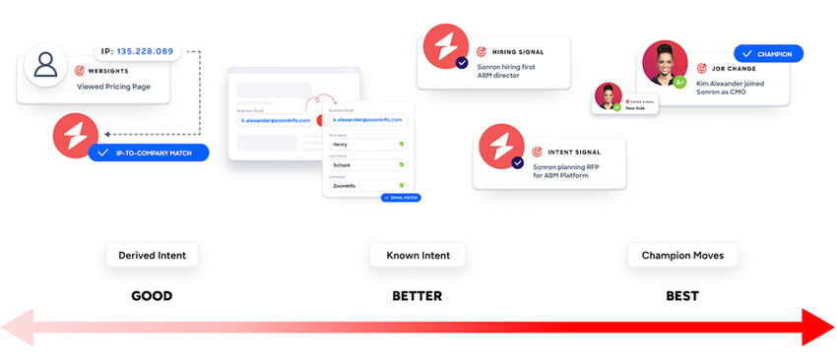
ZoomInfo Targeted LeadGen
Identify Ideal Customer Profiles (ICPs)
Advanced Search Filters
Account-Based Marketing (ABM)
Data Enrichment
Real-Time Alerts
Lead Scoring
Outbound Campaigns
Integration with Sales Tools
Intent Data
Data-Driven Outreach
AI and Machine Learning

Slide 35

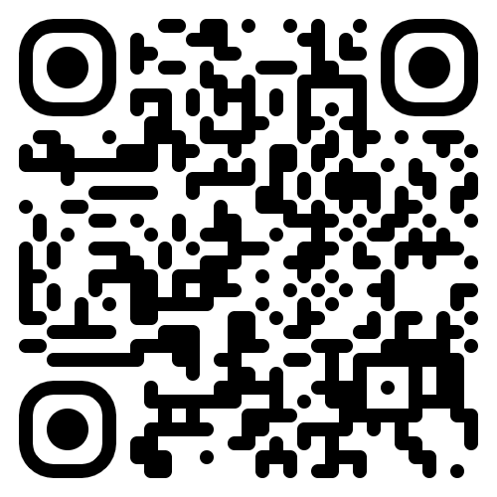
Free
Resources:
Scan here
Use your phone’s camera to get free resources from the event.

Slide 36
Things Quantum Can Help You With:
Manual Processes
Lack of Automation or AI
Disparate Technology Solutions that Don't Integrate
Sales Reps Spending Time Doing Everything but Selling
Lack of Alignment Between Sales and Marketing
Outdated Data
Inability to Pull Data from One System for Potential Opportunities
Lackluster Cross-Selling or Upselling to Your Current Client Base
Lack of Visibility into Key KPIs
Speed to Market
Inability to Accurately Track Performance and ROI
Struggling to Meet Budgetary Goals
Lack of Results
Challenges Responding to Ever-Changing Market Conditions
Underperforming Teams
Staffing Issues
Lack of Processes

Slide 37

Interested in learning more?
Complimentary 30 Minute Consultation with Shawn
5 Free 30-Day Assessments for First 5 to Sign Up
Free access to Quantum Academy through September of 2024

Slide 38

Thank you.

