Slide 1

How to Double Your Meetings in the Next 90 Days:
The Quantum Growth Model
Shawn Peterson | CEO Quantum Business

Slide 2
TOC: Day 1
Introduction
#3 Nurture
Q&A
The Quantum Growth Model
#4 Convert
Next Steps
#1 Target
#5 WOW
#2 Attract
Today’s Offers

Slide 3

Shawn Peterson
MEET OUR CEO & FOUNDER
Shawn Peterson is the CEO of Quantum Business Solutions, where he brings over a decade of executive-level experience in the technology services industry. A forward-thinking visionary, Shawn excels in driving high growth and superior performance through innovative strategies in sales, marketing, and client experience. His expertise extends to leveraging cutting-edge technologies, including automation, AI, and comprehensive tech stack integration, to enhance operational efficiency and financial performance.

Slide 4

About Quantum
Quantum Business Solutions specializes in optimizing your sales and marketing strategies for success through:
Go-To-Market Strategy, Specifically Tailored for the Office Technology Industry
Sales Tech Integrations
Lead Generation Services

Slide 5



Our Process
Optimize
Systemize
Automate
01
03
Clean Data, Ample Data, Segmented Data, High-Performing Tools
02
Centralized Data Hub with Full Tech Stack Integration
Technology Does the Heavy Lifting and Repeatable Tasks

Slide 6
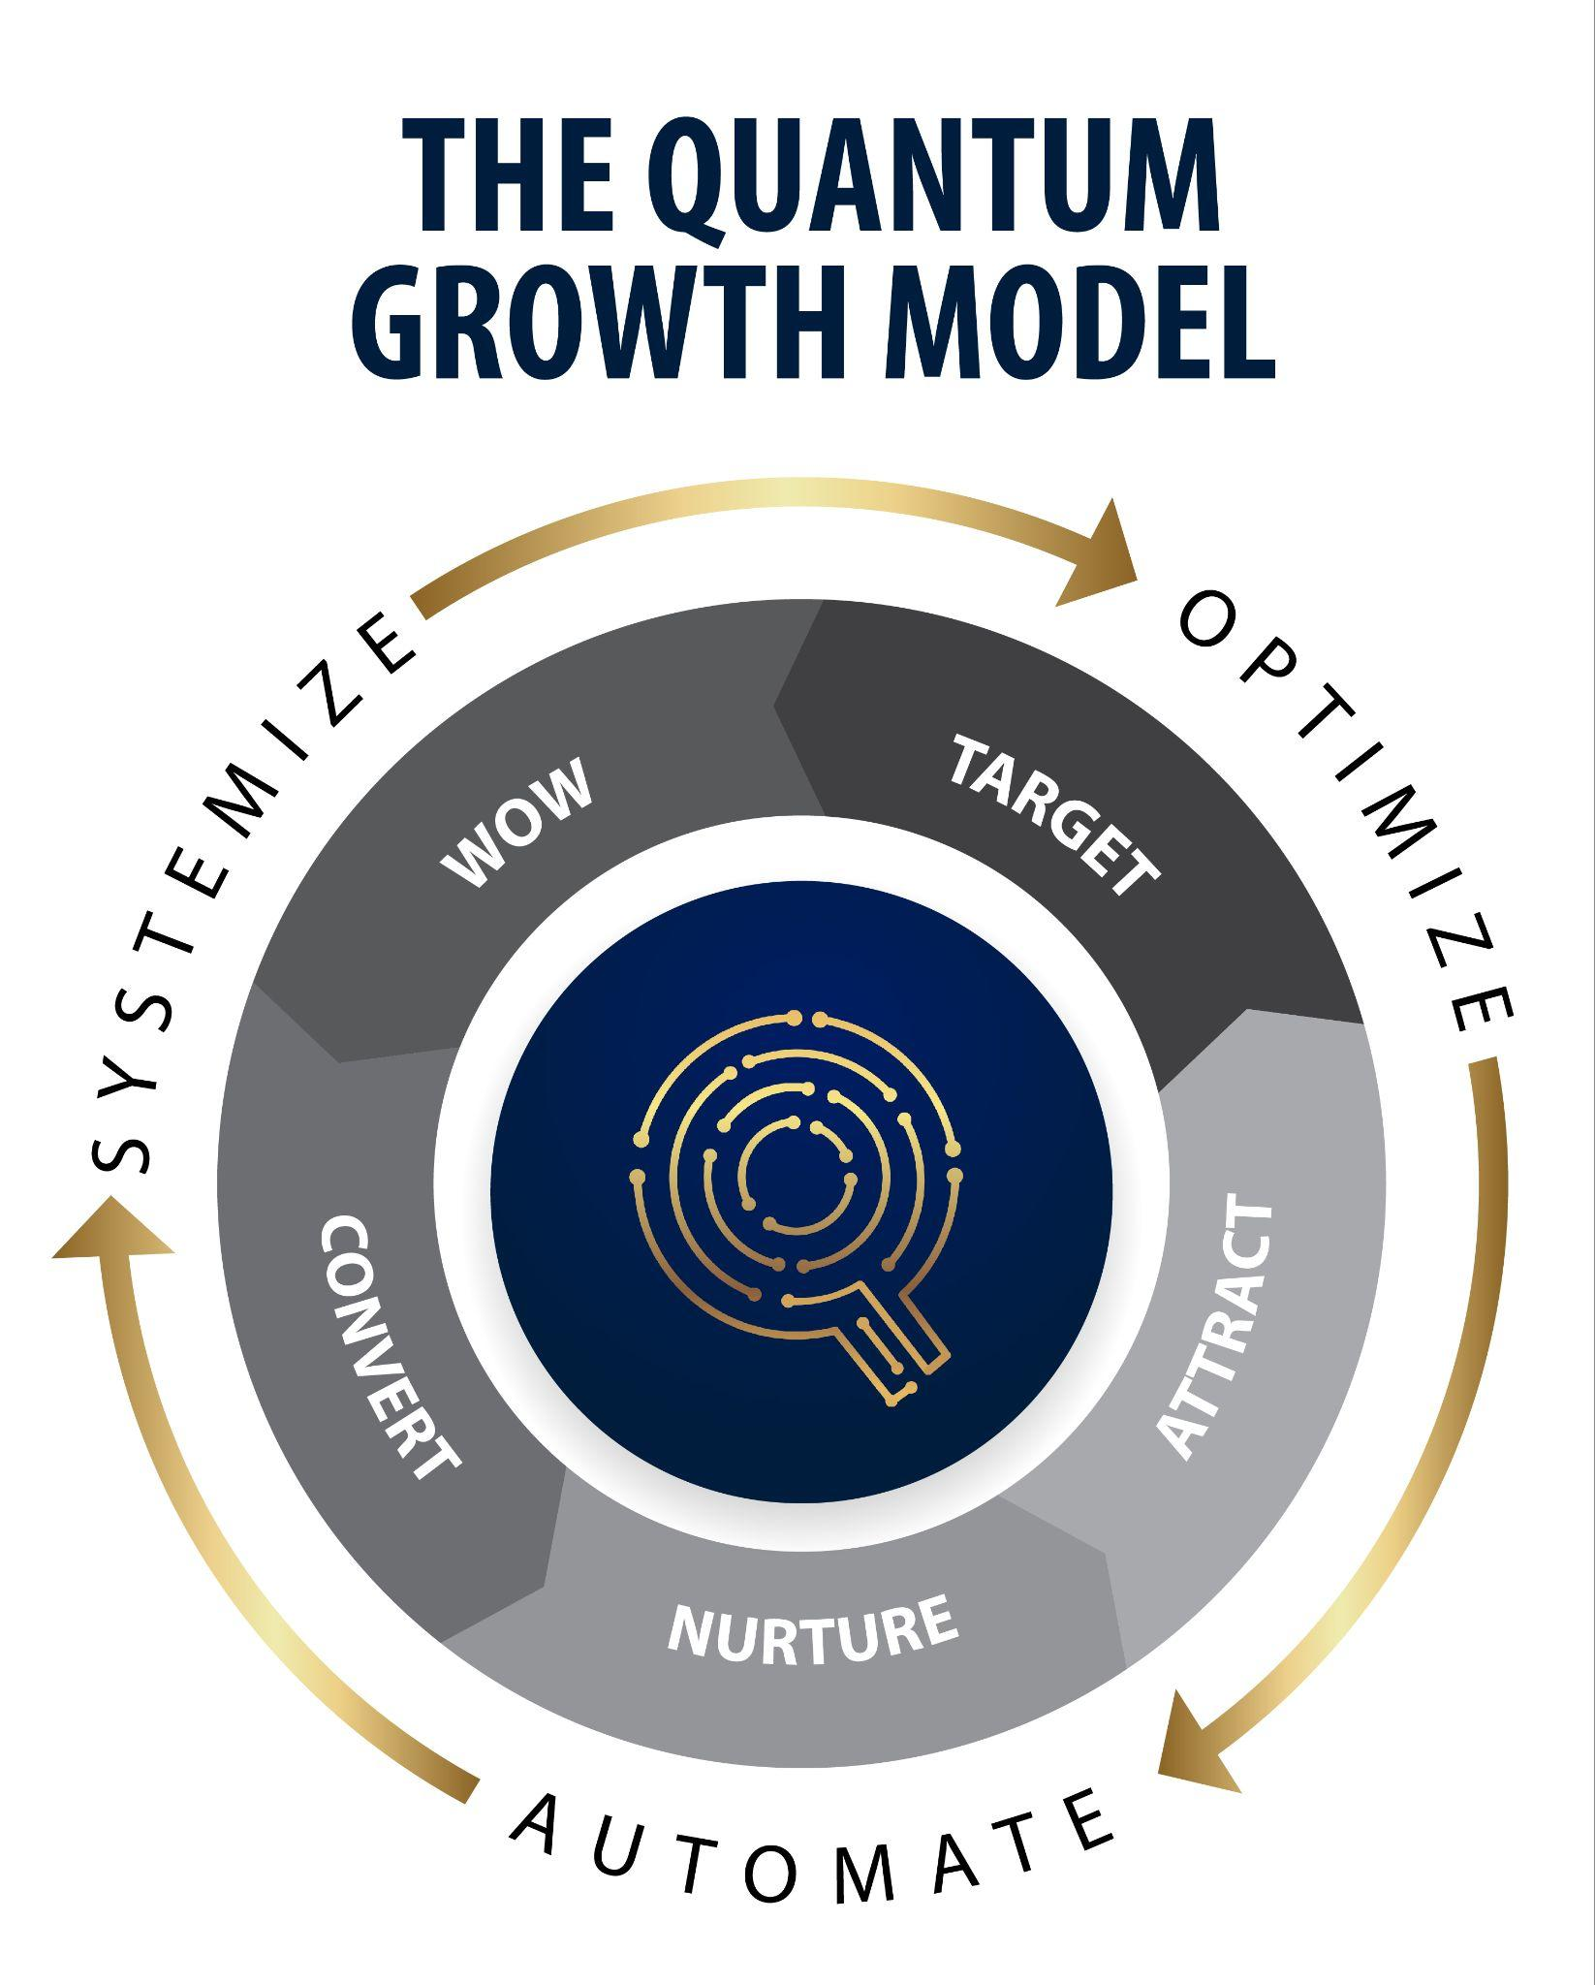
The Foundation
The 5 key components of the Quantum Growth Model, layered with AI and automation technology, create maximum sales velocity to effectively grow your revenue.
Target
Attract
Nurture
Convert
WOW

Slide 7
Meetings
How many of you would like to double the number of net new appointments for your team in the next 90 Days?

Slide 8
Key Components to Grow the Number of Sales Meetings
Systemized Approach
Centralized Hub
Integrated Tech Stack
Data, Including Data Enrichment and List Building Source
Automated and Segmented Lists to Leverage Data at Scale
Coordinated Sales and Marketing Campaigns and Efforts
Dedicated Callers (SDRs or Established, Non-Negotiable Blitz Time)
Power Dialer
High-Performance Sales Process to Book More Meetings

Slide 9
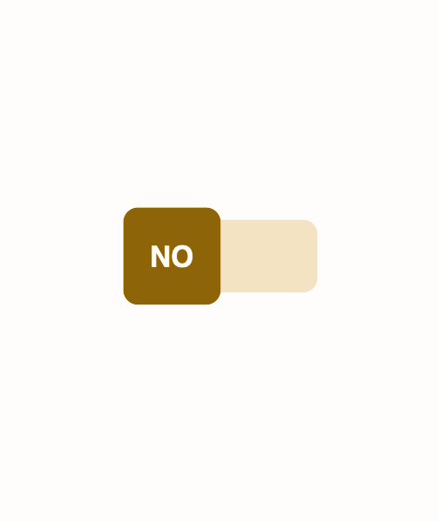
RevGen Process
Have you mapped out your RevGen processes?
Do you know what happens at each stage of the buyer’s journey?
Are these steps automated?

Slide 10
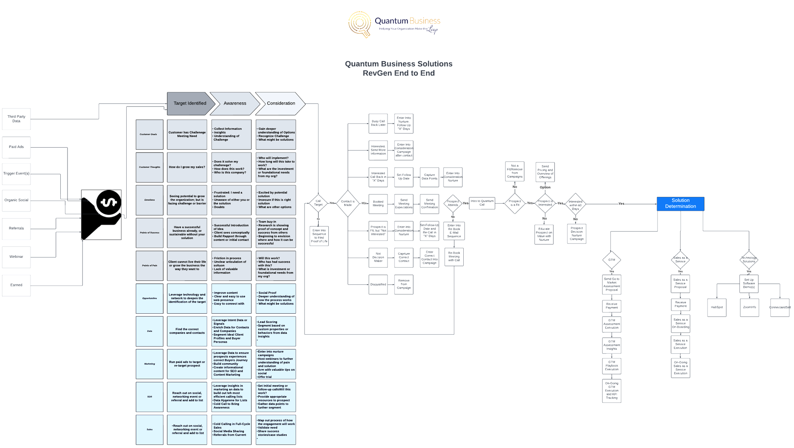

Slide 11
#1 Target
Data
Generate Leads

Slide 12
Target Audience
Demographics
Psychographics
Technographics
Pain Points
Have you clearly identified your target audience?

Slide 13
Ideal Client Profile (ICP)
Industry: Relevant sectors
Company Size: Employees/revenue
Location: Geographic regions
Job Title: Roles/titles
Pain Points: Challenges faced
Budget: Spending power
Technology Stack: Current tools
Buying Behavior: Purchase habits
Decision-Makers: Key influencers
Growth Potential: Expansion ability
Have you identified the right ICP for your various lead sources?

Slide 14
Buyer Personas
Job Title: Role in company
Seniority Level: Experience level
Responsibilities: Key duties
Goals: Primary objectives
Challenges: Main pain points
Preferred Channels: Communication methods
Content Preferences: Desired formats
Decision Criteria: Buying factors
Motivations: Driving forces
Values: Core beliefs
Technographic: Tech usage
Location: Geographic info
Have you identified the right buyer personas for your various lead sources?

Slide 15
Most Important Data Points
Mobile Numbers
Direct Dial Numbers
Email Addresses
Are you collecting the right data points for your target audience?

Slide 16
Leverage Data to Generate Potential Leads
CRM (Leads & Customers)
ERP (Customers & Competitors)
Professional Associations & Organizations
Event Attendees
Data Sources & Directories (ZoomInfo, Seamless.ai, LinkedIn Sales Navigator, etc.)
Content Marketing & Inbound Leads
Referral & Partner Programs
Paid Advertising & Lead Gen Services
Cold Calling
Business Directories
UCC Lists
What data sources do you have access to?

Slide 17
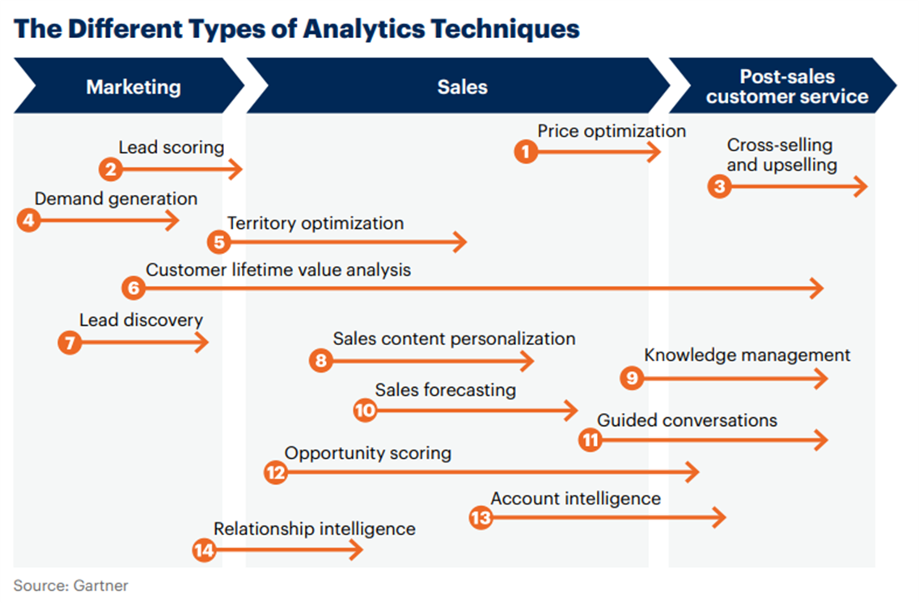
AI Can Augment Decision-Making

Slide 18
Free Billboard Space
Automated Meeting Links
QR Codes on All Printed Materials
QR Codes on Presentation Decks
QR Codes on Business Cards
Additional Services on Machine Stickers
Full Product Line-Up on Invoices
Email Footers
Leave-Behind Sheets for Service Calls
Survey Forms
Chatbots
Company-Wide Social Media Strategy
Building of Common Audiences on Social Media
Are you leveraging every opportunity to touch your target audience?

Slide 19

#2 Attract
Marketing
Appointment Setting

Slide 20
Multiple Touchpoints
Warm-Up Lists with Emails
  Resonates with Email Readers
  Increases Brand Awareness and Familiarity
  Additional Opportunity to Book Meetings (include meeting links)
Marketing Emails
  Educational Information
  Broader, but Still Segmented Audience Messaging
Sequence or One-to-One Emails
  More Personalized
  Highly Segmented Based on Criteria and Former Engagements or Outcomes
Calls
  Picker-Uppers
  Volume Reach with Auto-Dialers
Social Media
Text and Voicemail Drops
Different Contacts Respond to Different Types of Communications

Slide 21
Priority List Examples
Buyer Persona and ICP fit
Prior conversation/picker-upper
Opened email(s)
Clicked on emails
Repeat website visitor
Downloaded information
Lead Score Over X
No sales activity in 30+ days
Webinar attendee
Attended previous meeting but didn’t move forward
No show for meeting
Meets criteria for cross-sell or upsell
Deal created with no sales activity in 30+ days
Previous customer
Lists for Sales and Marketing Alignment
Coordinated Lists and Messaging for Call and Email Campaigns

Slide 22
Sales Appointments
Sales Appointment Goals and Strategies
Are you satisfied with the number of sales appointments being set by your team?
What methods are you using to set appointments?
1
3
2
Is your sales team meeting with the right contacts?
4
Do you have dedicated Sales Development Reps (SDRs)?

Slide 23
Methods
Sales Emails
Marketing Emails
Social Media
Paid Advertising
Sales Development Reps (SDRs)
Sales Blitzes
Outsourced Lead Gen
In-Person Cold Calls
Texting
Voicemail Drops
Webinars
Events
Other
What outreach methods are you currently utilizing to attract leads and book meetings?

Slide 24
How Quantum Sets Meetings
SDRs using ZoomInfo Sourced Data and ConnectandSell Power Dialer
Email Campaigns through HubSpot
Sales Sequence Emails in HubSpot
Voicemail Drops
Text Campaigns
AI Dialer
Webinar Attendees
Social Media Posts
Customer Referrals
Partner Referrals
Online Advertisement
In the past 30 days, Quantum has set sales meetings for our internal sales team through the following 11 methods:

Slide 25
Lead Gen with SDRs, Automated Enriched Lists, and Power Dialers
How much time each week do your reps spend cold calling on the phone?
How many meetings do your reps conduct each week?
Is your list building automated?
Do your lists feed directly into an auto-dialer?
Do your reps have any direct interaction with prospects prior to meetings?
The Power of Dedicated Reps and Automation

Slide 26
Cost per Meeting
Do you know what your current cost per meeting is?
If you were to increase your cost per meeting by 22% to get an 88% ROI by the end of 2024 through systemization, optimization, and automation would you do it?
Calculating ROI

Slide 27
Accelerated Outbound Motion
SDRs = Lower Cost per Meeting
Predictive Dialer, Such as ConnectandSell
Coordinated, segmented, and automated call, email, and social media campaigns
Integrated technologies for accurately tracking and updating information
The power of leveraging focused roles, automation, enriched data, and best-in-class technologies.

Slide 28
Automated Enrichment
Automated Lists
Automated Outreach
Contacts are identified and enriched in ZoomInfo. Enriched leads are moved directly into HubSpot via workflows.
Active lists are automatically updated as contacts meeting list criteria are added to the system.
Lists are loaded into the power dialer for SDR campaigns. Meetings are booked and scheduled for sales reps.
Automated meeting reminders are sent out.
Email campaigns warming up lists and based on call outcomes are automated.

Slide 29
Essential Elements for Lead Gen Success
Target
  ICP
  Buyer Persona
List
  Segmentation
  Contact Information (Mobile, Direct Phone, Email)
Message
  Script
  Content (Email, Ad, Social Post)
Delivery
  Rep
  Format
The Four Factors to Evaluate

Slide 30
List Performance
Is the criteria right?
Is it time for a new list?
Conversion Rate:
  Over 6% Pass
  4% - 6% Neutral
  Under 4% Fail
Meeting No Show Rate:
  65% + Pass
  50 - 59% Neutral
  Under 50% Fail
D2C: Dial to Contact:
  1 - 10 Pass
  11 - 20 Neutral
  Over 20 Fail
D2M: Dial to Meeting:
  > 400 Pass
  400 - 700 Neutral
  Over 700 Fail
Meetings per Hour:
  GT 0.41 Pass
  0.25 - 0.40 Neutral
  Under 0.25 Fail
Disposition Outcomes:
  No Show: never exceed 5%
  Disqualified: never exceed 5%
  Quick Hang-up: never exceed 10%
  No Pitch: never exceed 10%

Slide 31
Message: Screenplay
Sales and marketing alignment
Consistency
The Art of the Cold Call
Results
  # of Meetings Booked per Hour
  Goal = .5
Cold Call Scripts and Monitoring Success

Slide 32
Rep Performance
How often do you practice cold calling with your team?
Do you have established scripts?
Do you listen to live interactions?
Do you listen to call recordings?
Do you have a scorecard?
Tools, Training, Practice, Q/A, and Coaching

Slide 33
Live Demos
ConnectandSell
Air.Ai
The Power Dialer In Action
The AI SDR

Slide 34

#3 Nurture
Business Development

Slide 35
Right Message
Right Time
Right Audience
Target: Awareness
Attract: Consideration
Nurture: Decision
Convert: Conversion
WOW: Execution
Buyer’s Journey

Slide 36
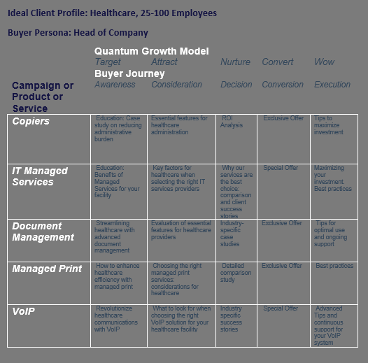

Slide 37
Lists for Business Development
Account Size
Contract Renewal Date
Lead Score Bumps Up
Lifecycle Stage Change
Pipeline Stage Change
Contact Change at Company
Call Outcomes
  Requests more information
  Requests follow-up
  Busy, call back later
  Not the decision-maker
Booked Meeting
  Meeting reminders
  Meeting follow-up
Registered for Event
Attended Event
List Hygiene
  Wrong contact information
  Asked not to contact
  Not a fit
Opportunities to Connect with High Priority Leads

Slide 38
Trigger Events & Automation
Call Outcome Trigger
Deal Stage Change Trigger
Lead Status Change Trigger
List Enrollment Trigger
Engagement Level Trigger
Lead Score Trigger
Time Based Trigger
7 Workflows to Implement Today Based on Trigger Events

Slide 39

#4 Convert
Sales

Slide 40
Pipeline Management
Customized Pipeline Stages
Automation: Workflows and Sequences Based on Stages and Activities
Lead Prioritization: Lead Scoring
Monitor Pipeline Health: Identify Bottlenecks
Maintain Clean Data
Schedule Regular Pipeline Reviews
Automated Dashboards and Analytics
Critical Components for a High-Performing Sales Pipeline

Slide 41
Lists to Close More Deals
Leads by Lead Source
Leads by Engagement Level
Leads by Contact Method Preference
Deals by Sales Stage
Deals by Deal Size
Deals by Close Date
Deals by Product/Service Offering
Deals by Lead Score
Deals by Engagement Level
Deals by Probability of Closing
Follow-Up and Post-Conversion Lists
  New Customers by Product/Service
  New Customers by Onboarding Stage
  Customers for Upsell/Cross-Sell Opportunities
  Customers for Referral Programs
List to Increase Conversion Rates

Slide 42

#5 WOW
Client Success
Retention

Slide 43
Client Retention
Develop robust systems and processes to keep clients satisfied, loyal to your brand, open to upsell and cross-sell opportunities, and enthusiastic about providing referrals.
Reduce Churn
Leverage Happy Customers

Slide 44
QBR Automation & Systemization
Do you have a systematized QBR process?
Does everyone ask for the same data in a QBR?
Where is the information collected in the QBR stored?
How is the data collected in a QBR leveraged for retention, cross-sell, and upsell?
Make Customer Information Actionable

Slide 45
Client Success Strategies for Existing Customers
Ongoing nurture campaigns
Automated gifting
Educational resources
NPS Score
Surveys
Product Usage and Adoption
Support and Service Interaction
Customer Advocacy and Referral
Community and Engagement
Tailored Approaches to Nurture, Engage, and Grow Your Customer Relationships

Slide 46

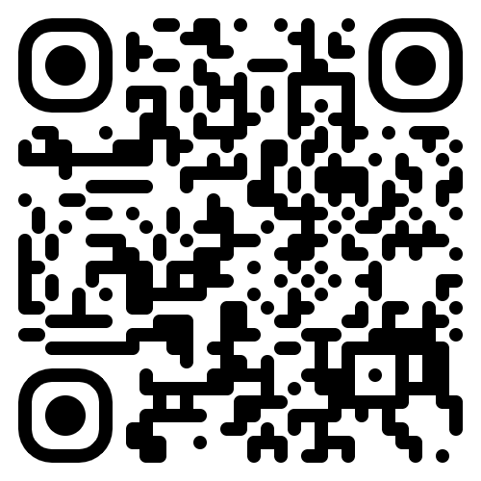
Free
Resources:
Scan here
Use your phone’s camera to get free resources from the event.

Slide 47
Things Quantum Can Help You With:
Manual Processes
Lack of Automation or AI
Disparate Technology Solutions that Don't Integrate
Sales Reps Spending Time Doing Everything but Selling
Lack of Alignment Between Sales and Marketing
Outdated Data
Inability to Pull Data from One System for Potential Opportunities
Lackluster Cross-Selling or Upselling to Your Current Client Base
Lack of Visibility into Key KPIs
Speed to Market
Inability to Accurately Track Performance and ROI
Struggling to Meet Budgetary Goals
Lack of Results
Challenges Responding to Ever-Changing Market Conditions
Underperforming Teams
Staffing Issues
Lack of Processes

Slide 48

Interested in learning more?
Complimentary 30 Minute Consultation with Shawn
5 Free 30-Day Assessments for First 5 to Sign Up
Free access to Quantum Academy through September of 2024

Slide 49

Thank you.

